Slide 1
Sociology: 3549 Central limit theorem
Recitation #6
Yue Chu

Slide 2
announcement
Homework solutions and grading rubrics are posted on Carmen
Module – Homework solutions and grading rubrics

Slide 3
agenda
Review of lecture
Activity
Population vs sample
Central limit theorem
Distribution of sample means
Probability of sample means
In class exercise question
Type your answer to Carmen for attendance

Slide 4
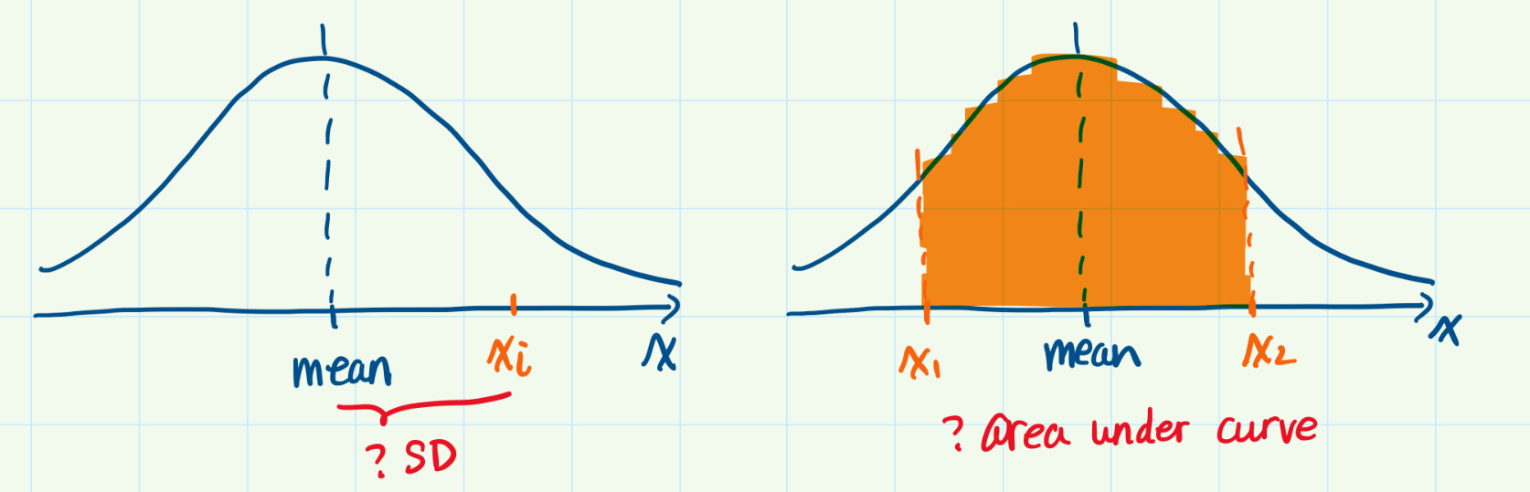
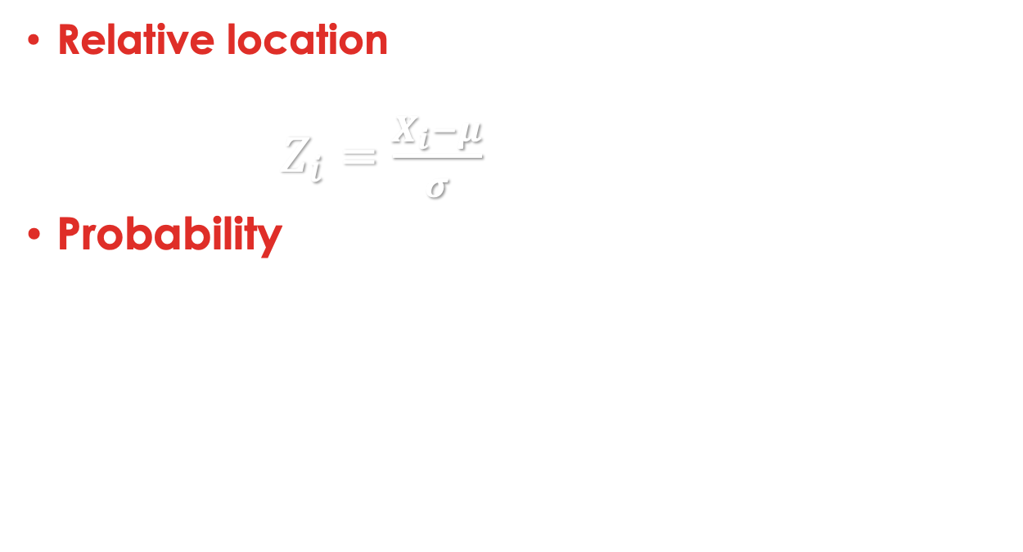
What we’ve learnt
Relative location of given raw score within distribution
z-score: $Z_{i}=\frac{X_{i}−μ}{σ}$
Probability of raw score falling within a certain range
Areas under the normal curve
Next: how well can you infer population parameter based on sample

Slide 5
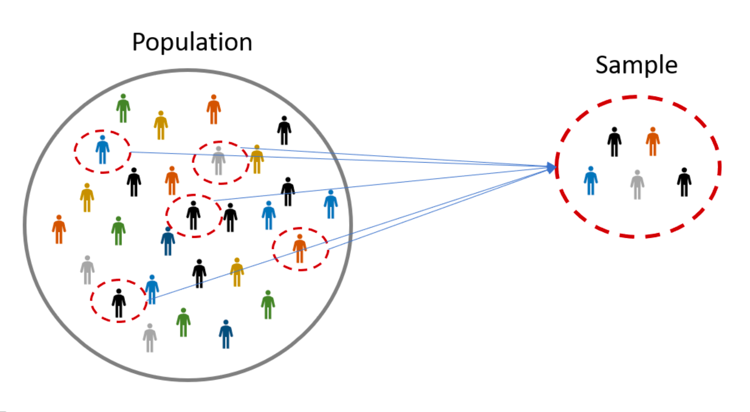
POPULATION VS SAMPLE
Population
Investigate ALL cases e.g. all Ohio residents for COVID status Often lack time/money or unnecessary to conduct in reality
Sampling
Sample
Investigate subset of population e.g. a few households in each county, 1 person per household Feasible and cost-effective

Slide 6
Descriptive vs inferential statistics
Inferential statistics
Trying to reach conclusions that extend beyond the immediate data alone: 1. Test hypothesis about single var. or association between variables. 2. Infer from the sample data to more general population
Sampling
Descriptive statistics
Describe the basic features of the data. Describing what the data shows (central tendency, dispersion)
Probability
Theory
Statistical inference
Notes:
Descriptive: Describe the basic features of the data in a study.
Simple summaries about the sample and the measure

Slide 7
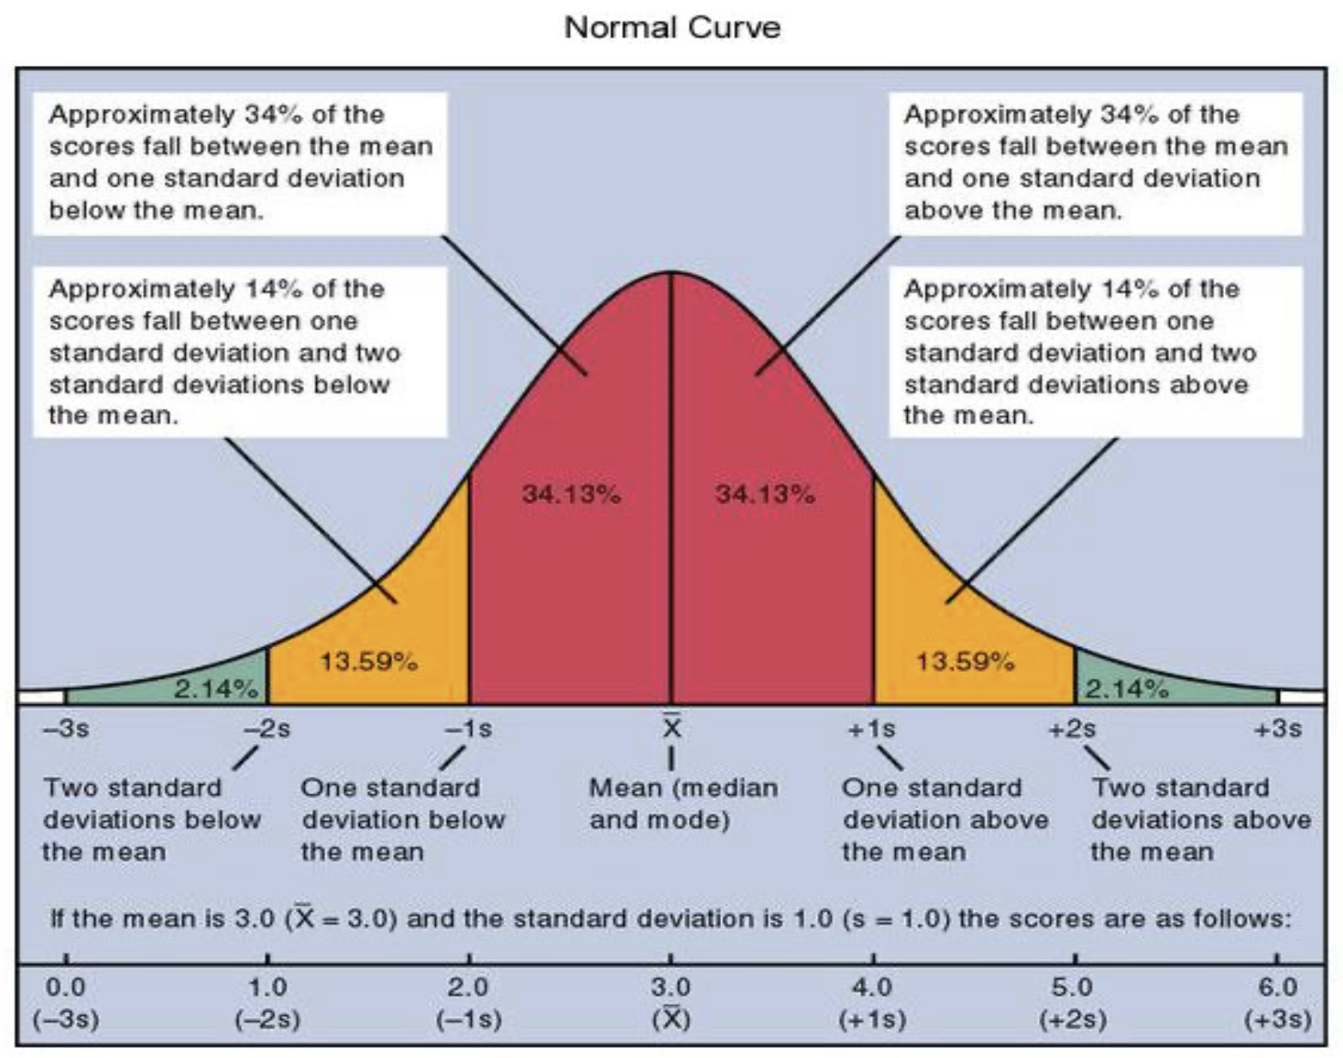
Probability theory
Identify most-likely-drawn samples
Theoretical connections between population and sample
Infer from sample back to population
Statistical inference
Notes:
Theoretical connections between population and sample
How your sample would behave if you know the “true” distribution of your population.
Infer from sample back to population
Use the sample to make statements about the entire population when we actually don’t know the truth

Slide 8
Population distribution
Distribution of interest Empirical Unknown
Sample distribution
Empirical Directly measured Not of primary interest
How your sample would behave if you know the “true” distribution of your population.
Notes:
Random sample
Each case has equal and known chance of being selected
Sample with replacement – sample probability for all draws

Slide 9
Sampling distribution
The probability distribution of a statistic based on random sampling
Random sampling:
Equal and known chance of being selected
Sample with replacement
Notes:
Simplest way of selecting sample from population

Slide 10
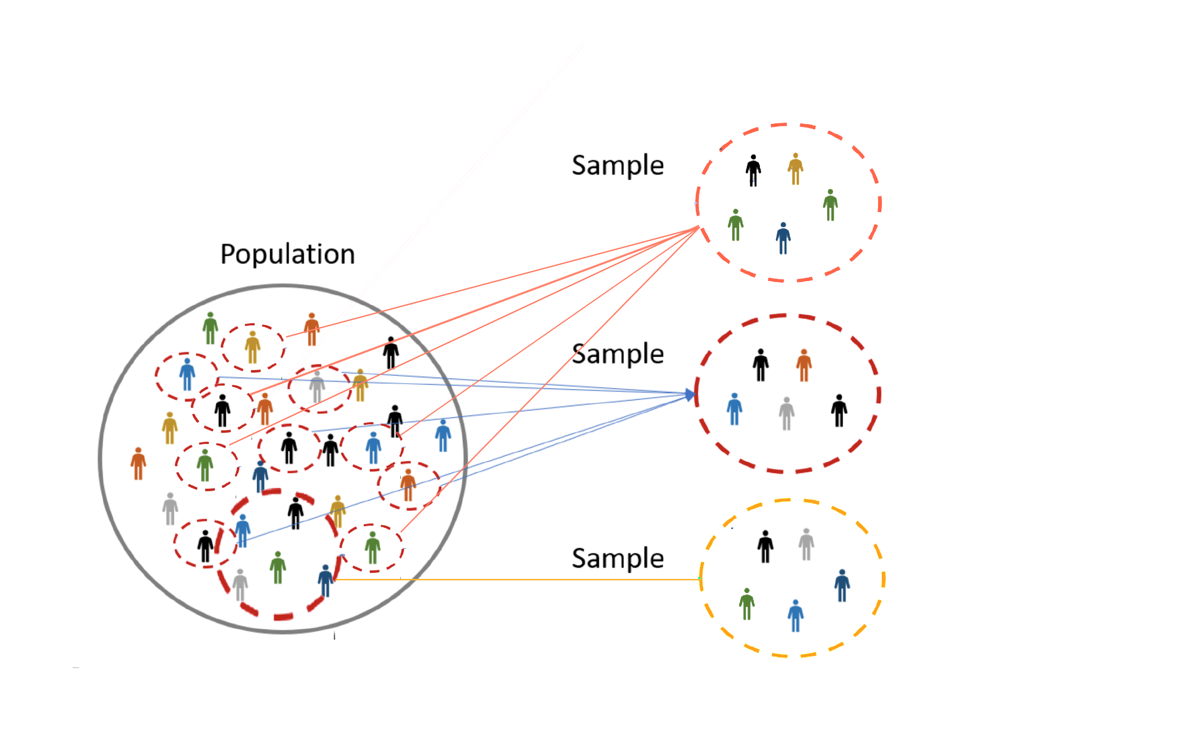
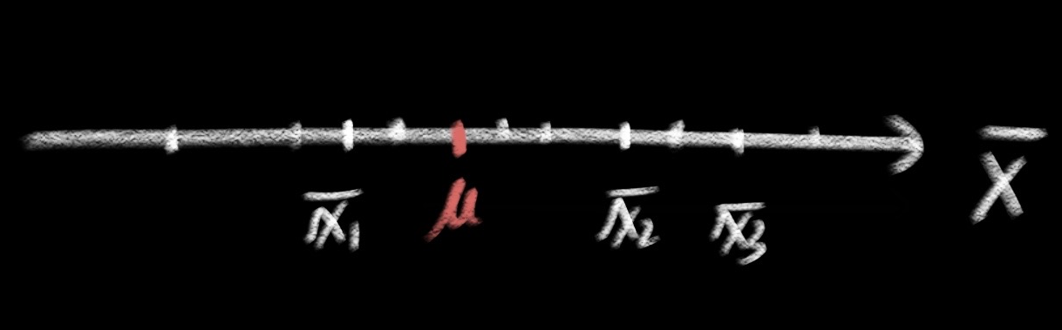
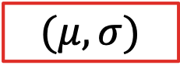



Sampling distribution
$$(μ, σ)$$
$${\overline{x}}_{1}$$
Different from one another
Different from population
$${\overline{x}}_{2}$$
$${\overline{x}}_{3}$$
…

Slide 11
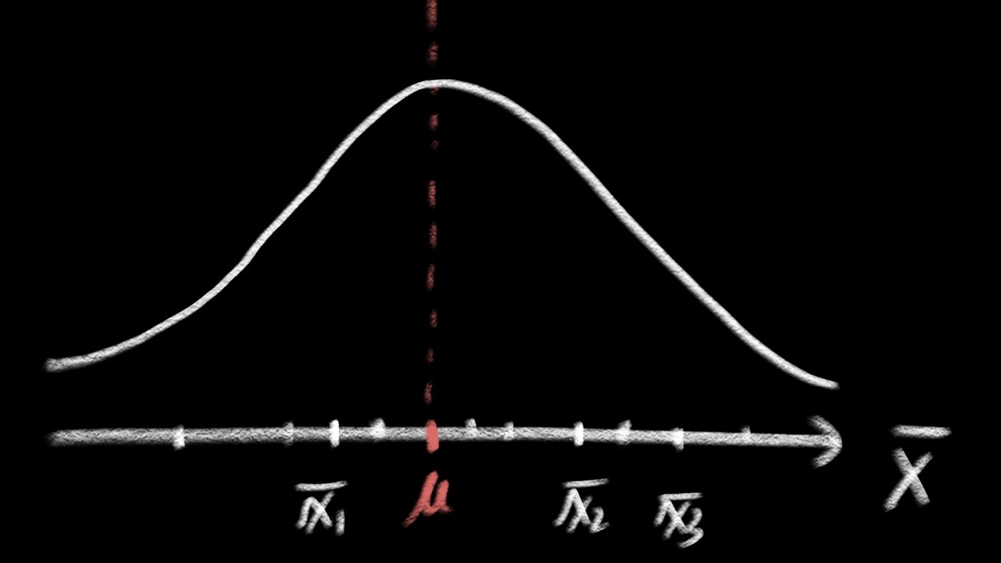
Sampling distribution
But collectively, with large enough samples, the distribution of sample means approximates normal distribution
$$(μ, σ)$$
$${\overline{x}}_{1}$$
$${\overline{x}}_{2}$$
$${\overline{x}}_{3}$$
…

Slide 12

Distribution of sample mean
Theoretical distribution
Sample means for all possible random samples of a particular size (n) that can be obtained from a population.
Normal distribution
Mean: population mean $μ$
Standard deviation: standard error
Notes:
Figure source: https://psychology.illinoisstate.edu/jccutti/psych340/fall02/oldlecturefiles/prob.html

Slide 13



Central limit theorem (CLT)
If you have a population
with mean = $μ$ and SD = $σ$
Take sufficiently large random samples of size $n$ with replacement
Distribution of sample mean will be approximately normally distributed
With mean= $μ$ and SE $=\frac{σ}{√n}$
Notes:
The central limit theorem states that if you have a population with mean μ and standard deviation σ and take sufficiently large random samples from the population with replacement, then the distribution of the sample means will be approximately normally distributed. This will hold true regardless of whether the source population is normal or skewed, provided the sample size is sufficiently large (usually n > 30). If the population is normal, then the theorem holds true even for samples smaller than 30.

Slide 14

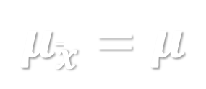
MEAN
Mean of distribution of sample mean is population mean $μ$
Also called expected value of $\overline{x}$
It is an unbiased estimator of population mean
Meaning, if you take infinite number of samples, average of sample means will exactly be population mean
$$μ_{\overline{x}}=μ$$

Slide 15


Standard error
Standard error is the standard deviation of all possible sample means
$$SE=σ_{\overline{x}}=\frac{σ}{√n}$$
Interpretation:
Average distance between sample mean for samples with size n and true population mean
Solely determined by $σ$ and $n$: As n increases, SE decreases
Sample means from larger samples is closer to true pop mean
Larger samples more accurately / reliably reflect true pop mean
Notes:
Standard deviation of the sample divided by the square root of the sample size
Measures typically how far the mean of a sample with sample size n deviates from the true population mean

Slide 16
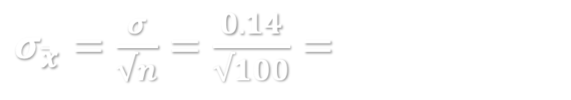
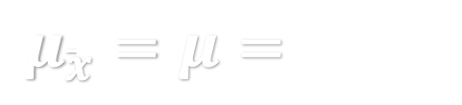
example
Birth weight example
Birth weight example: Mean = 3.23kg, SD = 0.14kg
Take 1000 random samples, each with size 100.
What do you know about the distribution of sample means?
Distribution of sample means:
Mean: SE:
Interpretation:
On average, sample means for samples with 100 births differs from true population mean by 0.014.
If I take 1 random sample of size 100, will the distribution change？
$μ_{\overline{x}}=μ=$3.23kg
$σ_{\overline{x}}=\frac{σ}{√n}=\frac{0.14}{√100}=$0.014
Notes:
Standard deviation of the sample divided by the square root of the sample size
Measures typically how far the mean of a sample with sample size n deviates from the true population mean

Slide 17
In-class exercise
Test score example
GRE verbal: Mean = 150.8, SD = 8.5
Take 400 random samples, each with 50 students.
Question 1:
What’s the distribution of sample means?
Describe both the central tendency and dispersion.

Slide 19
implications of CLT
1
As sample size n increases, the distribution of sample means approximates normal distribution, regardless of shape of population distribution.
2
With large enough sample size n, the mean of distribution of sample means is unbiased estimation of true population mean
3
As sample size increases, the size of SE (average distance between sample mean and true population mean) decreases
Sample means clusters around true population mean, normally distributed
Samples with larger sample size deviates less from true population mean
Single random sample with large enough sample size provides good estimate of true population mean
Notes:
SE is only affected by: variability of population distribution, sample size
Makes it possible to generalize from sample to population

Slide 20
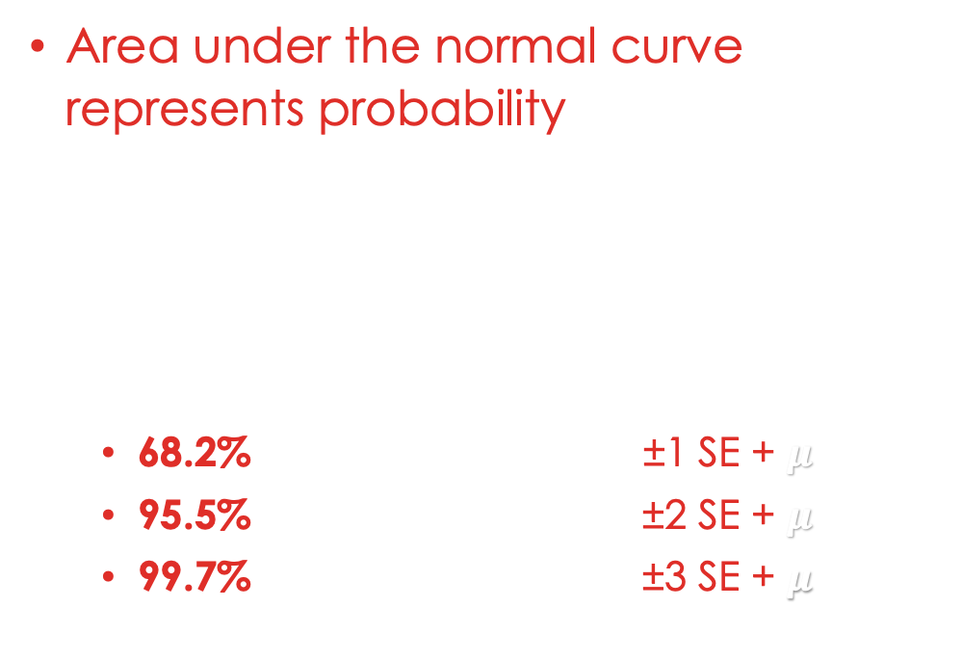
Probabilities of sample means
Area under the normal curve represents probability that a sample mean is within a range in the distribution of sample means
68-95-99 Rule
68.2% of sample means ~ ±1 SE + $μ$.
95.5% of sample means ~ ±2 SE + $μ$.
99.7% of sample means ~ ±3 SE + $μ$.

Slide 21
Step by step calculation
convert
Convert raw score raw sample means to z score
draw
Identify the area of interest in the standard normal curve
find
Find absolute value of your z score in Appendix A – column A
Calculate
Calculate and interpret

Slide 22
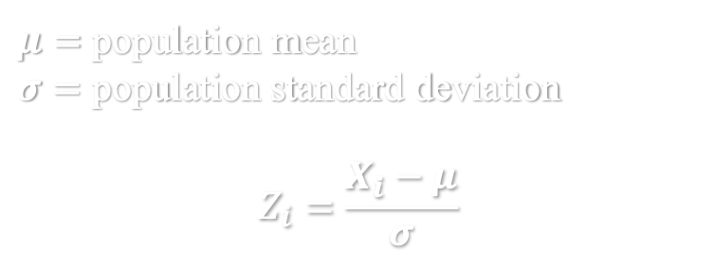
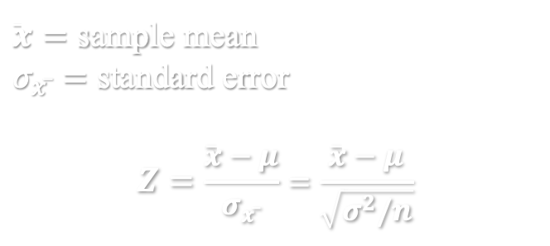
z-score for sample means
In distribution of raw scores
In distribution of sample means
$μ=$ population mean
$σ=$ population standard deviation
$$Z_{i}=\frac{X_{i}−μ}{σ}$$
$\overline{x}=$ sample mean
$σ_{x ̅}=$ standard error
$$Z=\frac{\overline{x}−μ}{σ_{x ̅}}=\frac{\overline{x}−μ}{\sqrt{σ^{2}/n}}$$
Interpretation
Z-score for raw score: how many standard deviation RAW SCORE is from population mean
Interpretation
Z-score for sample mean: how many standard deviation SAMPLE MEAN is from population mean
Notes:
Convert the variance back to original metric

Slide 23
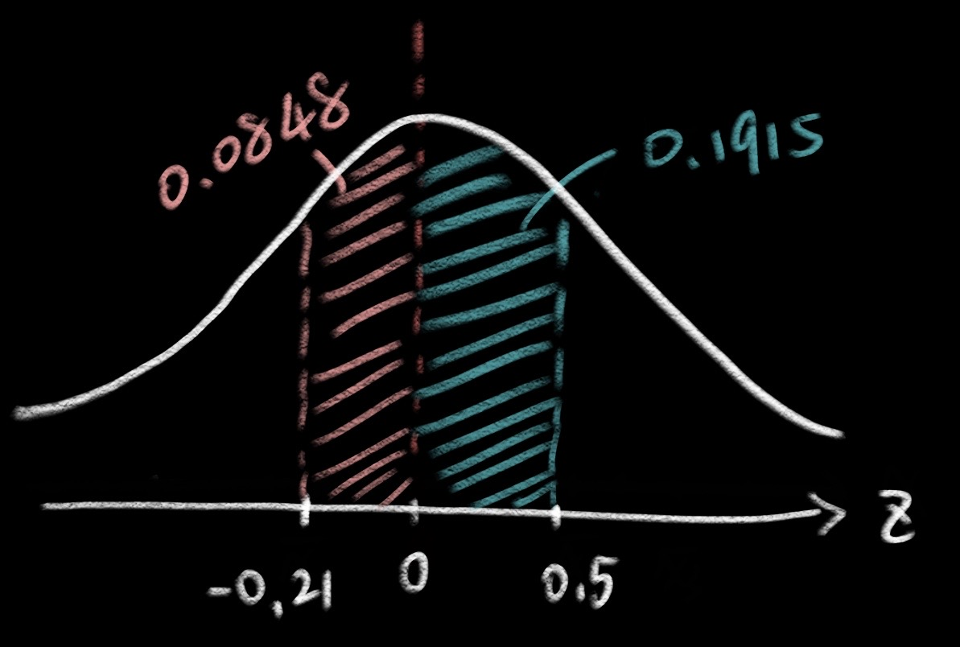
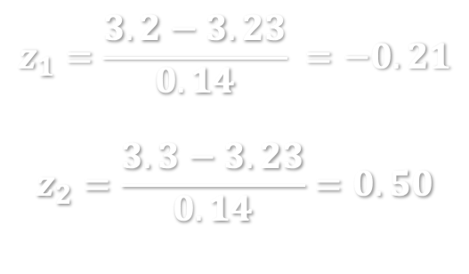
Example for probability of raw score (last week)
Birth weights of girls: have mean = 3.23 kg, SD = 0.14 kg
What is the probability of a randomly selected girl having birth weight between 3.2 and 3.3 kg?
Convert
Draw
Find
Calculate
$$z_{1}=\frac{3.2−3.23}{0.14} =−0.21$$
$$z_{2}=\frac{3.3−3.23}{0.14}=0.50$$
0.0848+0.1915=0.2763
Interpretation:
The probability of a randomly selected girl in US having birth weight between 3.2 and 3.3 kg is 27.63%.

Slide 24
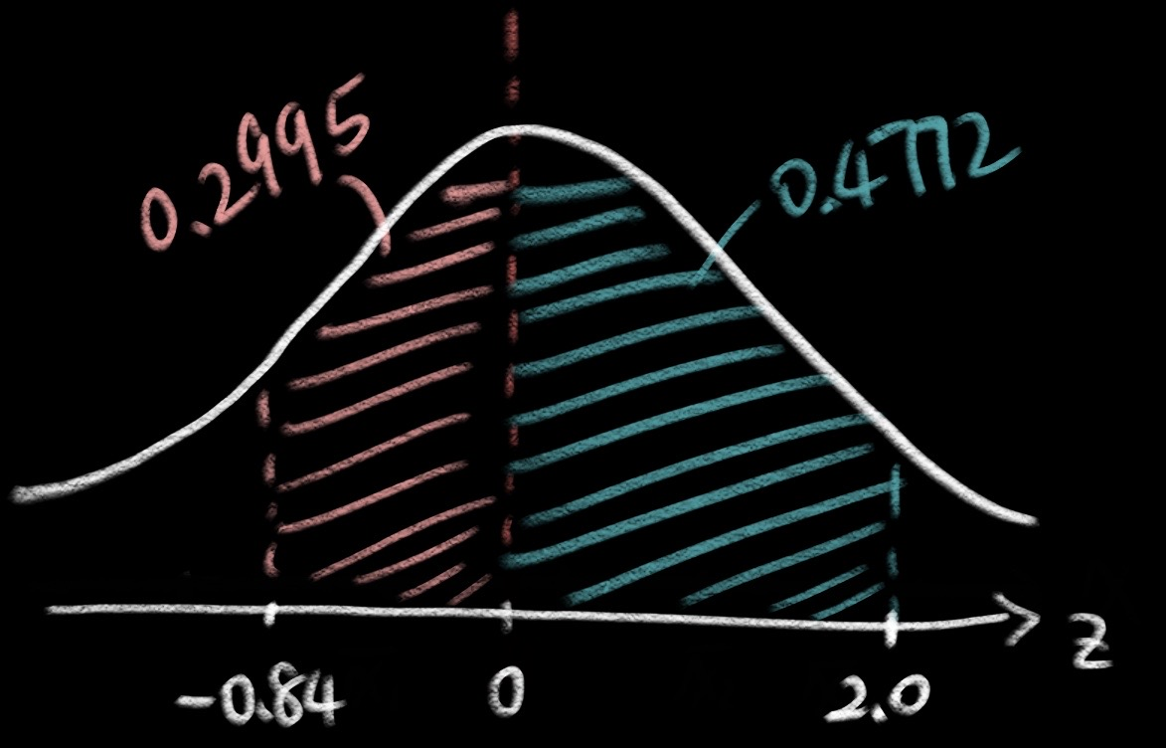
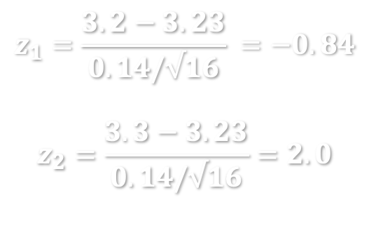
Example for probability of sample mean
Birth weights of girls: have mean = 3.23 kg, SD = 0.14 kg
Probability of the mean birth weight of 16 randomly selected sample of girls falls between 3.2 and 3.3 kg?
Convert
Draw
Find
Calculate
$$z_{1}=\frac{3.2−3.23}{0.14/√16} =−0.84$$
$$z_{2}=\frac{3.3−3.23}{0.14/√16}=2.0$$
0.2995+0.4772=0.7767
Interpretation:
The probability of a randomly selected sample of 16 girls with mean birth weight between 3.2 and 3.3 kg is 77.67%.

Slide 25
In-class exercise
Test score example
GRE verbal: Mean = 150.8, SD = 8.5
Take 400 random samples, each with 64 students.
Question
What’s the distribution of sample means?
Specify the central tendency and dispersion.
Percentage of sample with mean score above 148.
Type your answer in Carmen – Lab attendance Oct.12

